Slide 1
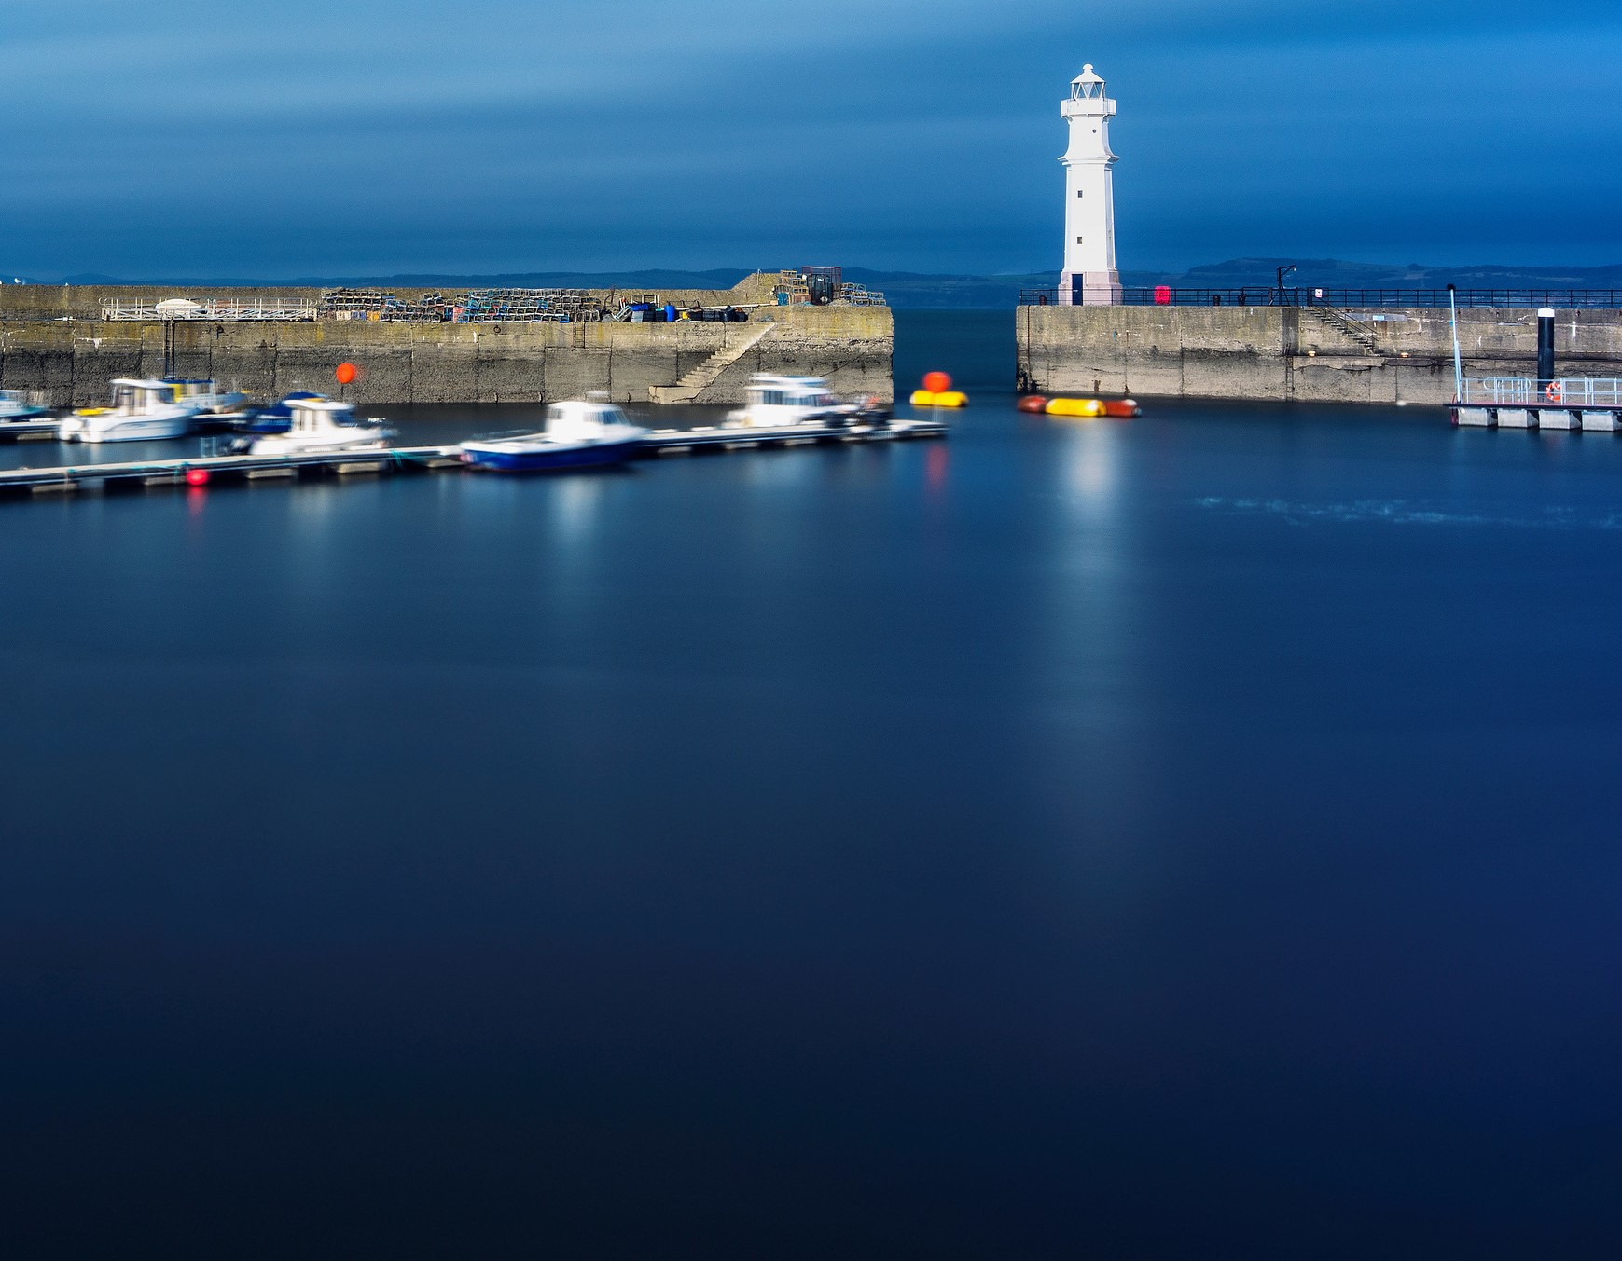
From “Lockdown” by Brother Richard, of the Capuchin Franciscan Community
…all over the world people are slowing down and reflecting All over the world people are looking at their neighbours in a new way All over the world people are waking up to a new reality To how big we really are. To how little control we really have. To what really matters. To Love.

Slide 2
From “Lockdown” by Brother Richard, of the Capuchin Franciscan Community
So we pray and we remember that Yes there is fear. But there does not have to be hate. Yes there is isolation. But there does not have to be loneliness. Yes there is panic buying. But there does not have to be meanness. Yes there is sickness. But there does not have to be disease of the soul Yes there is even death. But there can always be a rebirth of love.

Slide 3
From “Lockdown” by Brother Richard, of the Capuchin Franciscan Community
Wake to the choices you make as to how to live now. Today, breathe. Listen, behind the factory noises of your panic The birds are singing again The sky is clearing, Spring is coming, And we are always encompassed by Love. Open the windows of your soul And though you may not be able to touch across the empty square, Sing.

Slide 4
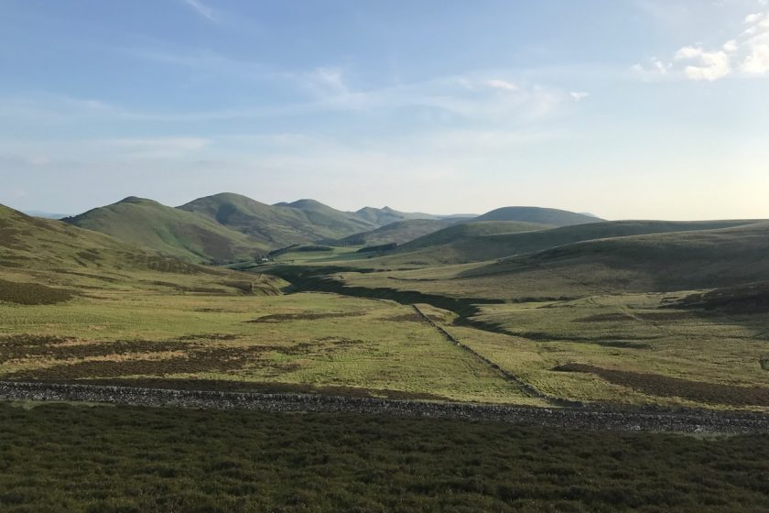
Psalm 121
¹ I lift up my eyes to the mountains – where does my help come from? ² My help comes from the Lord, the Maker of heaven and earth.
³ He will not let your foot slip – he who watches over you will not slumber; ⁴ indeed, he who watches over Israel will neither slumber nor sleep.
⁵ The Lord watches over you – the Lord is your shade at your right hand; ⁶ the sun will not harm you by day, nor the moon by night.
⁷ The Lord will keep you from all harm – he will watch over your life; ⁸ the Lord will watch over your coming and going both now and for evermore.

Slide 5
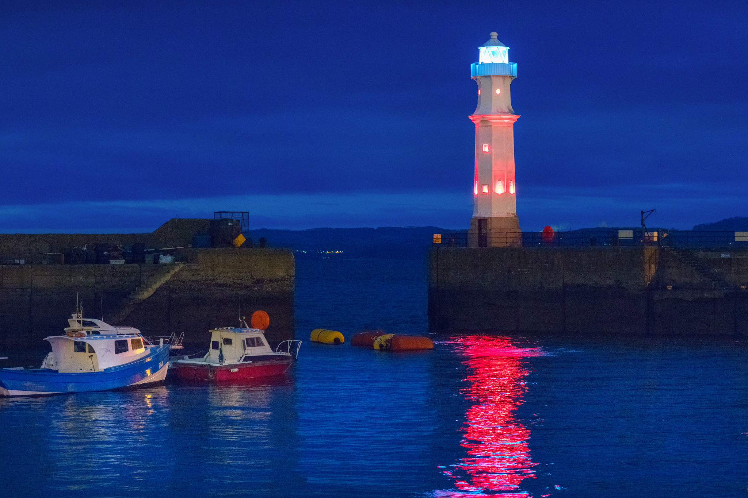
⁸ For you were once darkness, but now you are light in the Lord. Live as children of light ⁹ (for the fruit of the light consists in all goodness, righteousness and truth) ¹⁰ and find out what pleases the Lord.
¹¹ Have nothing to do with the fruitless deeds of darkness, but rather expose them. ¹² It is shameful even to mention what the disobedient do in secret. ¹³ But everything exposed by the light becomes visible – and everything that is illuminated becomes a light.
¹⁴ This is why it is said:
‘Wake up, sleeper, rise from the dead, and Christ will shine on you.’
Ephesians 5:8-14
(reading for the fourth Sunday in Lent)

Slide 6
Please pray for…
People you know who are afraid – that they may know God’s peace
People you know who are isolated – that they may know God’s presence
People you know who are confused by what’s happening – that they may trust in God’s Word
All those who are especially vulnerable, because of underlying health conditions – that God would protect them

Slide 7
Please pray for…
People you know who are in Care Homes – that they may not feel forgotten
All those who are working in the health and care sectors – that they may know God’s strength
Those throughout the world who, because of war, or poverty, or personal circumstances, are finding it hard to find the support they need
Please pray for…
Us all – that we may be Christ’s body on earth, sharing his love and compassion with all in need

