Slide 1
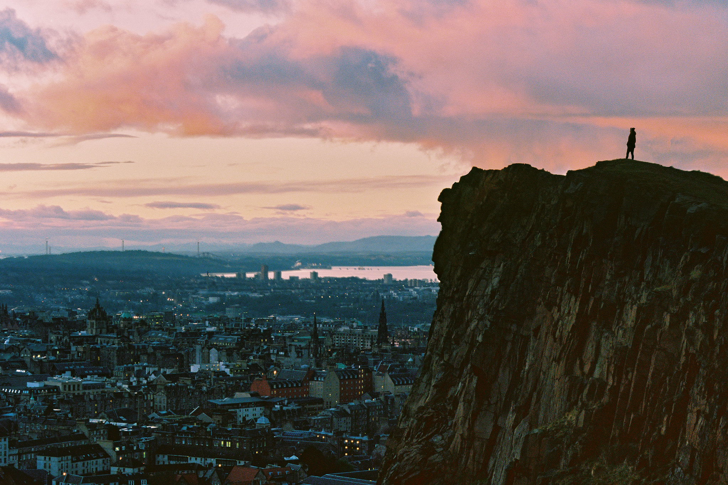
Compassionate God we come to you in our need confessing to you what we often dare not admit to ourselves:
it is hard to celebrate life when faced with the mystery of death.
It is hard to look to the future when surrounded by the uncertainty of the present;
it is hard to embrace the day when hope is eclipsed by despair.
From “Lockdown” by Brother Richard, of the Capuchin Franciscan Community
…all over the world people are slowing down and reflecting All over the world people are looking at their neighbours in a new way All over the world people are waking up to a new reality To how big we really are. To how little control we really have. To what really matters. To Love.

Slide 2
From “Lockdown” by Brother Richard, of the Capuchin Franciscan Community
Help us this day to know you and find you in the whole of life: its beginnings and its endings,
to discover you in our pain as well as our joy, in our doubts as well as our believing,
to receive this day, and in the days to come. comfort from your word and light for our darkness.
Amen.
(With thanks to Islay Baptist Church)
…all over the world people are slowing down and reflecting All over the world people are looking at their neighbours in a new way All over the world people are waking up to a new reality To how big we really are. To how little control we really have. To what really matters. To Love.

Slide 3
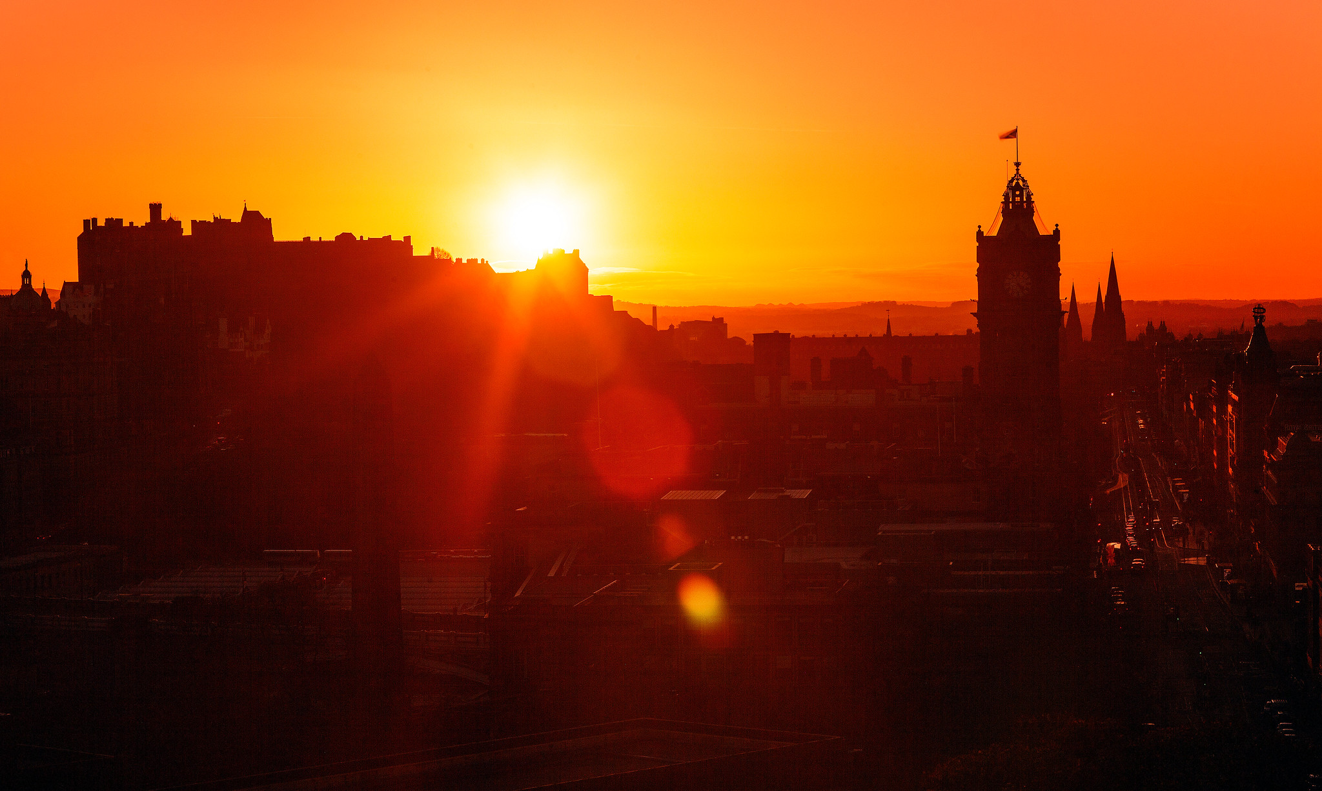
Psalm 130
¹ Out of the depths I cry to you, Lord; ² Lord, hear my voice. Let your ears be attentive to my cry for mercy.
³ If you, Lord, kept a record of sins, Lord, who could stand? ⁴ But with you there is forgiveness, so that we can, with reverence, serve you.

Slide 4
⁶ I wait for the Lord more than watchmen wait for the morning, more than watchmen wait for the morning.
⁷ Israel, put your hope in the Lord, for with the Lord is unfailing love and with him is full redemption. ⁸ He himself will redeem Israel from all their sins.

Slide 5
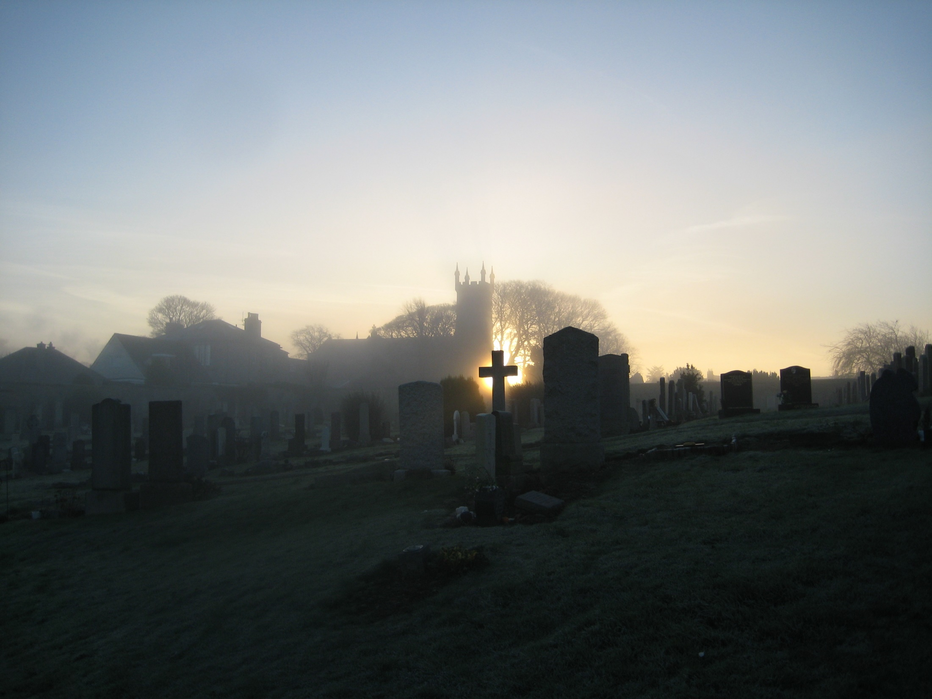
²⁵ Jesus said to her, ‘I am the resurrection and the life. The one who believes in me will live, even though they die; ²⁶ and whoever lives by believing in me will never die.
Do you believe this?’
²⁷ ‘Yes, Lord,’ Martha replied, ‘I believe that you are the Messiah, the Son of God, who is to come into the world.’
John 11.25-27 (reading for the fifth Sunday in Lent)

Slide 6
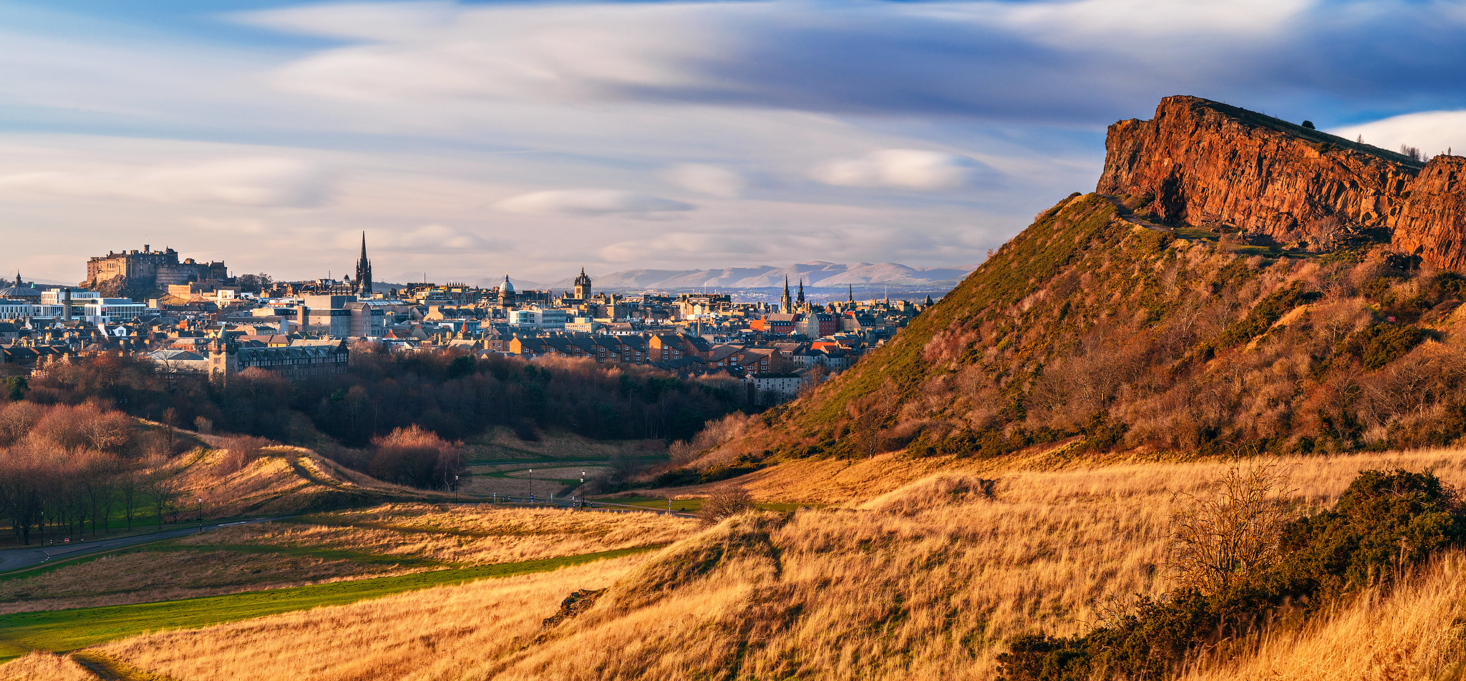
Please pray for…
People you know who are finding life difficult at the moment – that they may not feel forgotten
All those who are working in the NHS, and all volunteers – that they may keep healthy themselves

Slide 7
Please pray for…
Those throughout the world who, because of the coronavirus, are finding it impossible to have the additional support they need
Our own families, as we go through this time of trial
A sense of God’s presence for everyone in the church family – so that even when we are apart we can be together in the Holy Spirit

Slide 8
Please pray for…
People who are confused by what’s happening – that they may see that there is much that we do not understand, and more to discover about faith and hope
Us all, that we can be examples of Christ’s body on earth to our friends and neighbours

Slide 9
Bible Verse for the Week
Jesus said…..” I am the good shepherd.
The good shepherd sacrifices his life
for the sheep.”
John 10 verse 11

