Slide 1
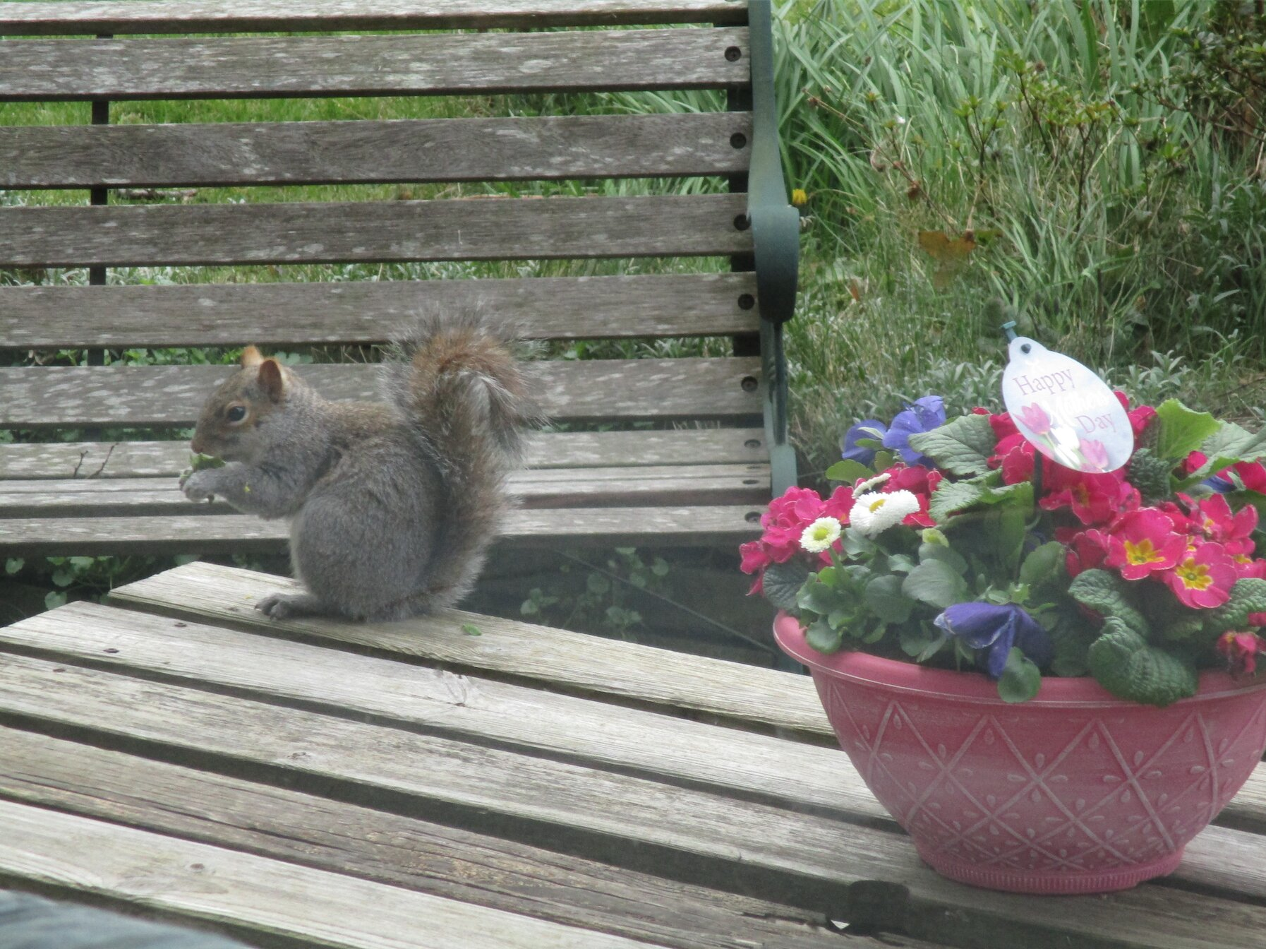
Dear Lord Jesus,
as we look around we see signs of spring, new birth, new hope. We see flowers emerging after their winter’s sleep, we see birds, squrrels, signs of excited life.
We can benefit from reflecting on the old childrens’ hymn, at this time of struggle for the whole of humanity…
God, Who made the earth, The air, the sky, the sea, Who gave the light its birth, He cares for me
God, Who made the grass, The flower, the fruit, the tree, The day and night to pass, He cares for me.

Slide 2
God, Who made the sun, The moon, the stars, is He Who, when life’s clouds come on, He cares for me.
God, Who made all things, On earth, in air, in sea, Who if I lean on Him, Will care for me.
God, who sent his Son To die on Calvary, He, if I lean on him, Will care for me.

Slide 3
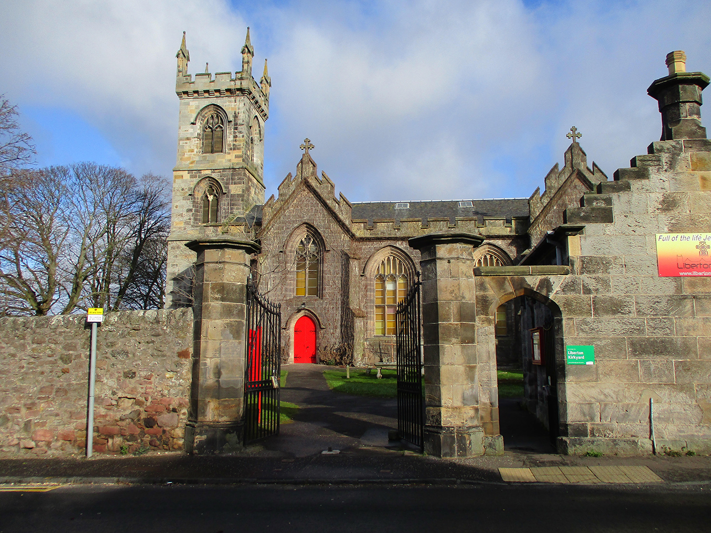
Psalm 118.19-29
¹⁹ Open for me the gates of the righteous; I will enter and give thanks to the Lord. ²⁰ This is the gate of the Lord through which the righteous may enter. ²¹ I will give you thanks, for you answered me; you have become my salvation.
²² The stone the builders rejected has become the cornerstone; ²³ the Lord has done this, and it is marvelous in our eyes. ²⁴ The Lord has done it this very day; let us rejoice today and be glad.

Slide 4
²⁵ Lord, save us! Lord, grant us success!
²⁶ Blessed is he who comes in the name of the Lord. From the house of the Lord we bless you. ²⁷ The Lord is God, and he has made his light shine on us. With boughs in hand, join in the festal procession up to the horns of the altar.
²⁸ You are my God, and I will praise you; you are my God, and I will exalt you.
²⁹ Give thanks to the Lord, for he is good; his love endures for ever.

Slide 5
Matthew 21.7-11 (Reading for the 6th Sunday in Lent)
⁷ They brought the donkey and the colt and placed their cloaks on them for Jesus to sit on. ⁸ A very large crowd spread their cloaks on the road, while others cut branches from the trees and spread them on the road. ⁹ The crowds that went ahead of him and those that followed shouted,
‘Hosanna to the Son of David!’
‘Blessed is he who comes in the name of the Lord!’
‘Hosanna in the highest heaven!’
¹⁰ When Jesus entered Jerusalem, the whole city was stirred and asked, ‘Who is this?’
¹¹ The crowds answered, ‘This is Jesus, the prophet from Nazareth in Galilee.’

Slide 6
Please pray for…
Those who have been bereaved recently – that they may experience your peace.
Those who are ill, that they may experience your healing touch.
Scientists, who are trying to find answers and solutions to this pandemic – that they may work with Your values in mind.
All those we know and love, who are finding life a struggle at the moment.
Our church family, as we try to remember Palm Sunday, during these times of restrictions. Help us to raise our eyes to the heavens , and keep us from being pulled down by earthly concerns.
Pray for the body of Christ worldwide, and thank You for our unity.

Slide 7
Bible Verse for the Week
Jesus said…..“I am the way and the truth and the life. No-one comes to the Father except through me .”
John 10 verse 11

